Slide 1


BTMA 431 FINAL PROJECT
Air quality & Weather Analytics
Across Canadian Cities

Slide 2


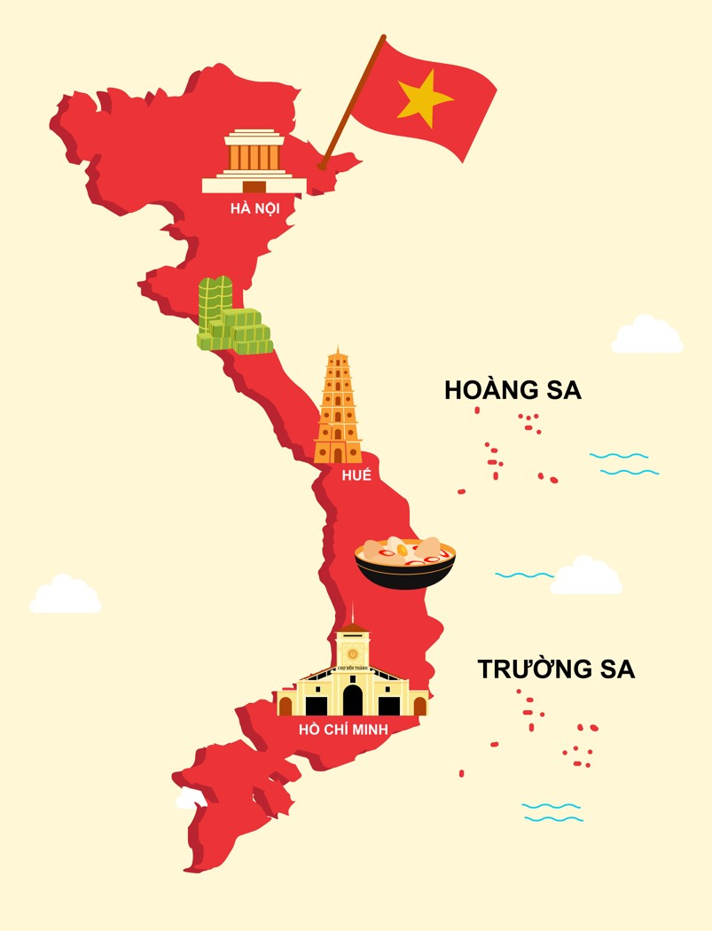
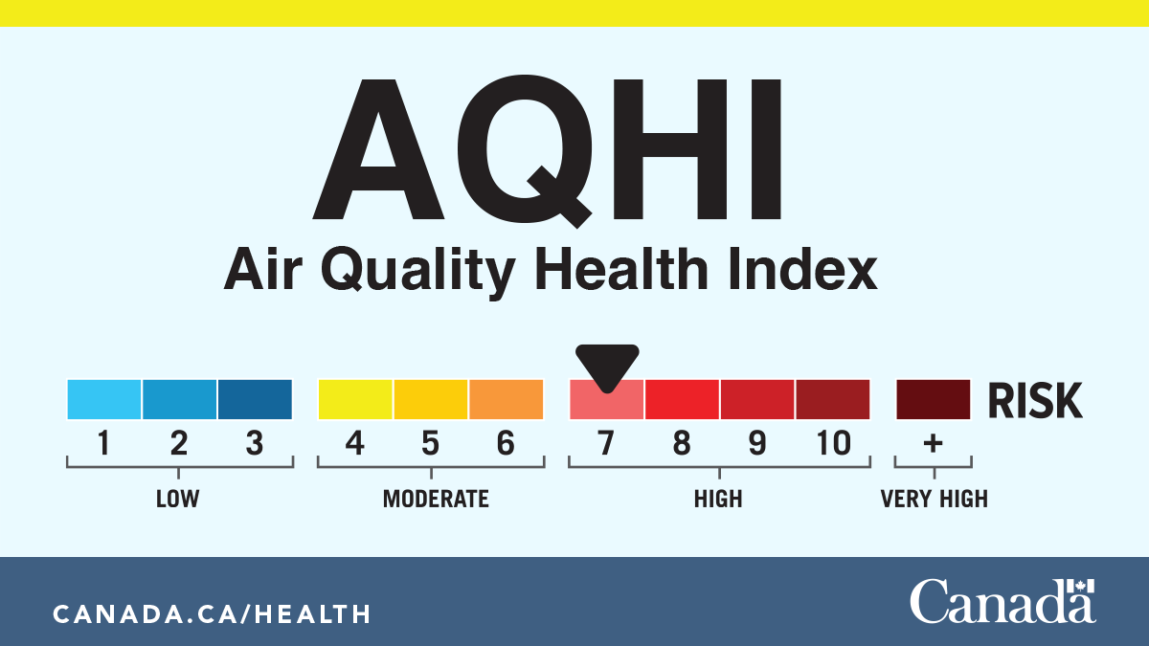
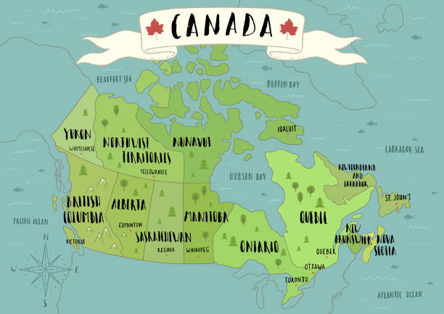
About me – Why I choose this topic
Hieu Dinh
FROM VIETNAM’S TROPICAL CLIMATE TO CANADA‘S AQHI SYSTEM
3rd Year Business Analytics

Slide 3
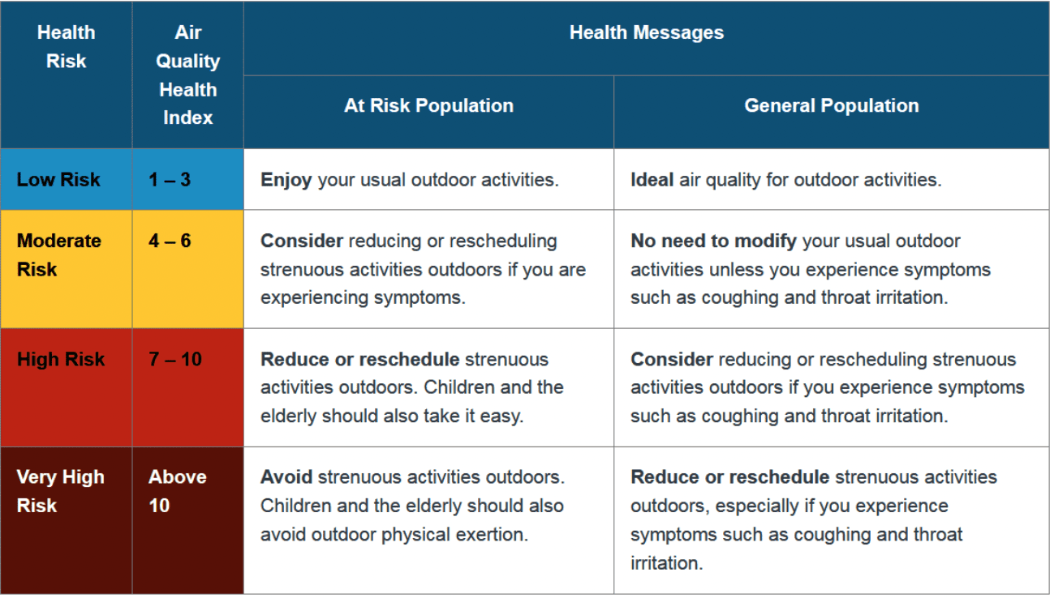

What is AQHI ?
AQHI is Canada’s air quality health index.
It measures short-term health risks based on:
• Ozone (O₃)
• Fine Particulate Matter (PM2.5)
• Nitrogen Dioxide (NO₂)

Slide 4



Factors That Affect AQHI Levels
Weather Conditions
Geographic Location
Time

Slide 5

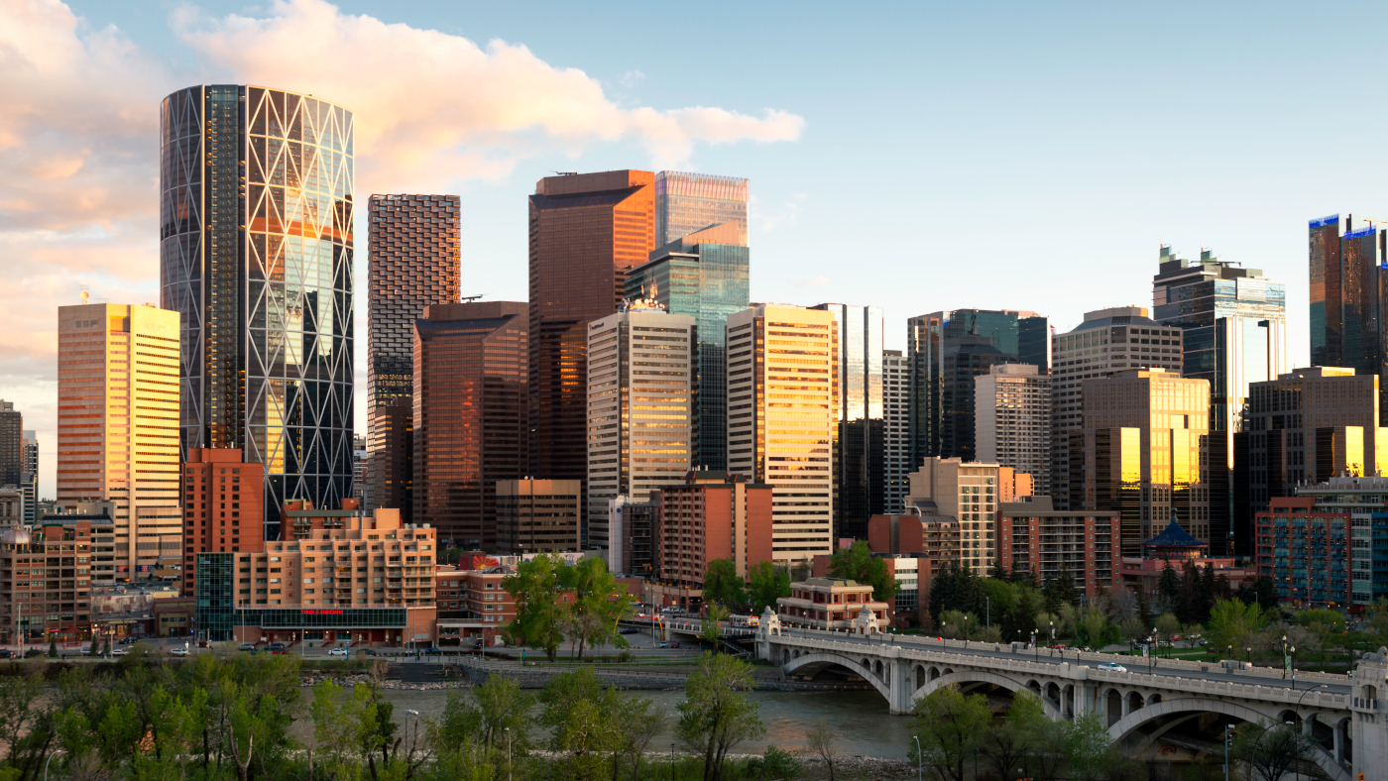
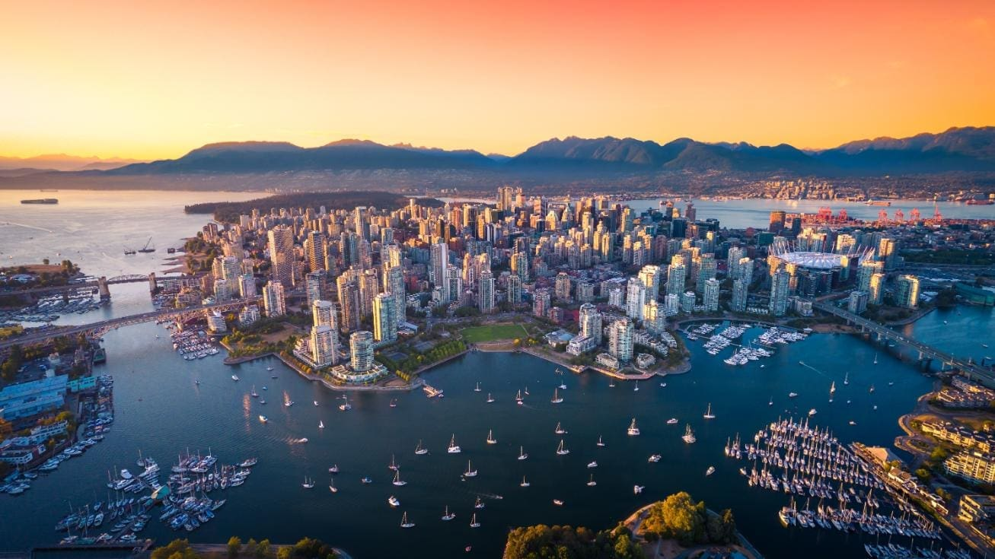
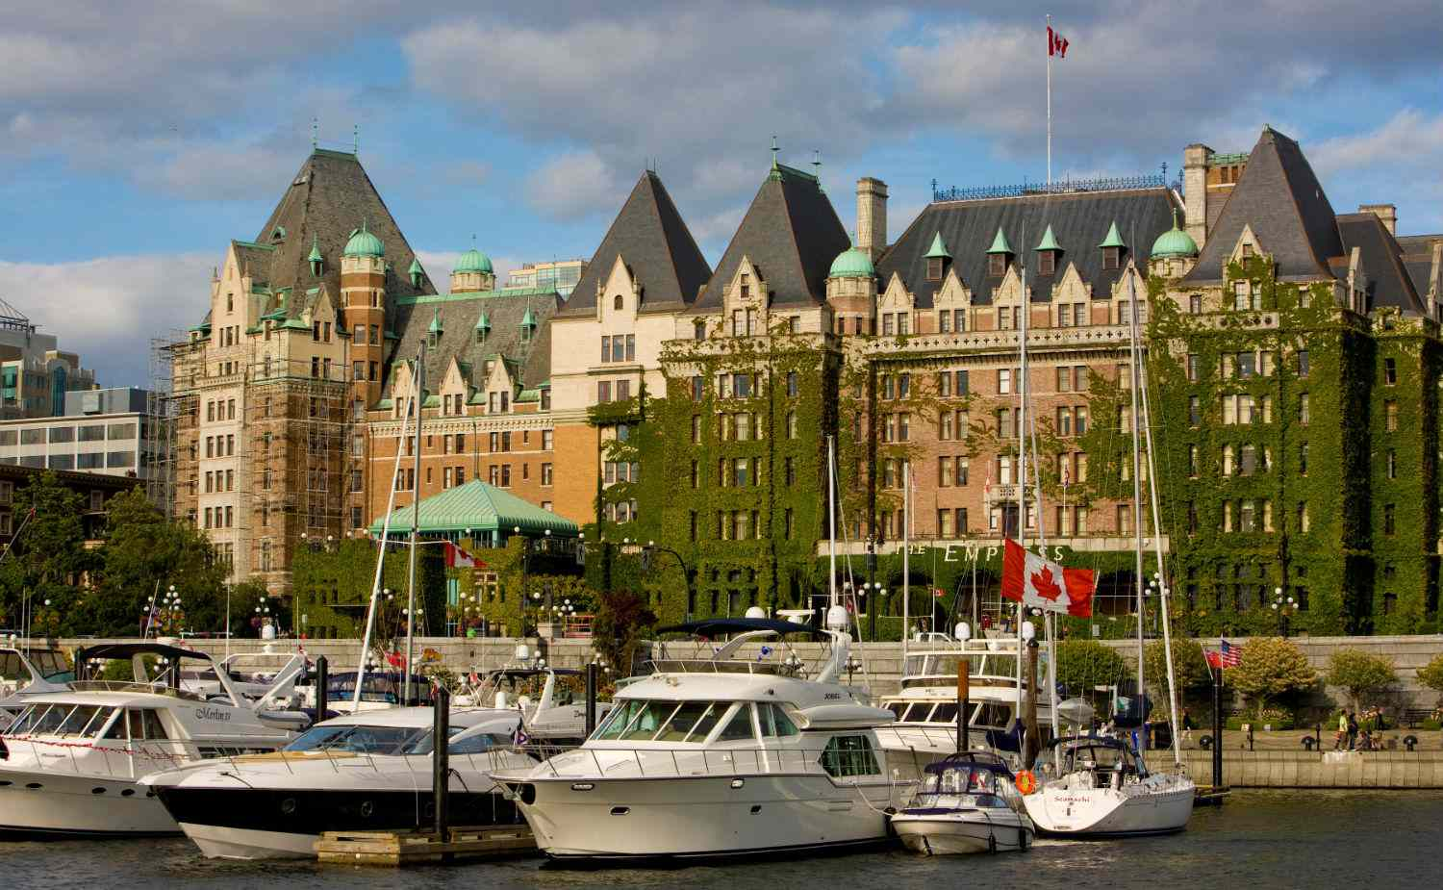
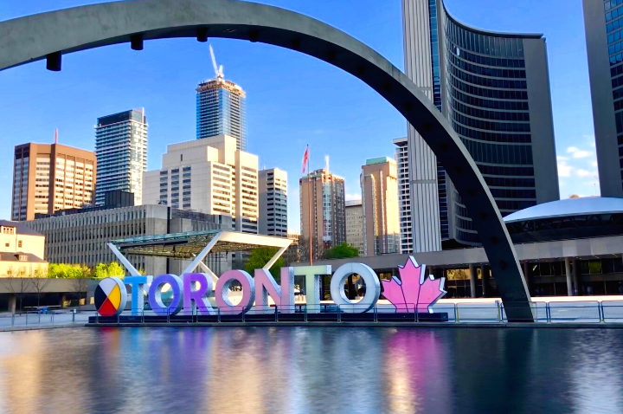
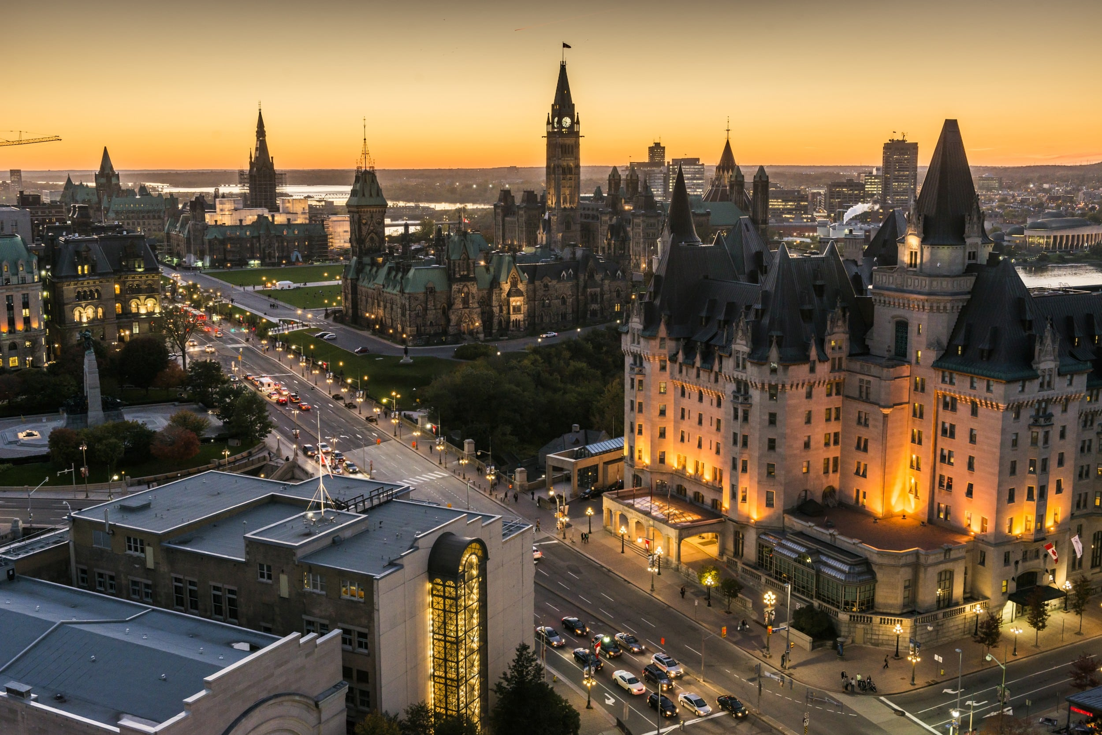
Five Canadian Cities Analyzed
Calgary
Vancouver
Victoria
Toronto
Ottawa

Slide 6
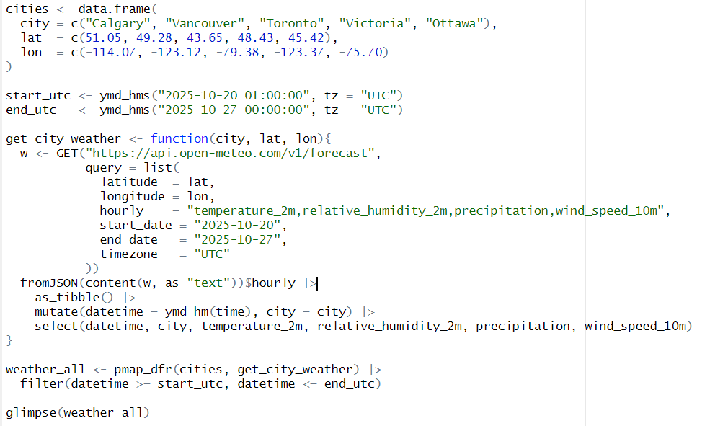

"
📌 API request (latitude/longitude + parameters)
📌 Convert JSON → tibble
📌 Merge multiple cities into one dataset

Slide 7
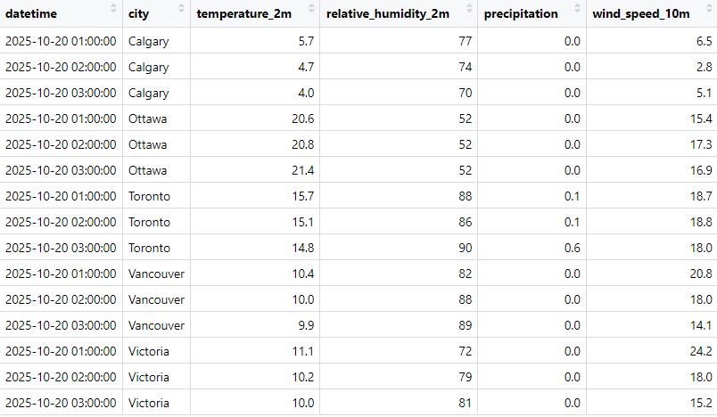
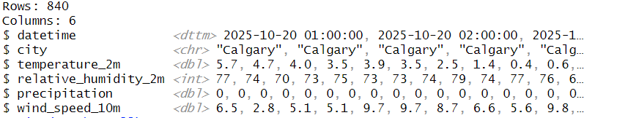
📌 Preview of the dataset
📌 The full dataset has 840 rows from 5 cities
📌 Includes datetime, city, and 4 key variables

Slide 8
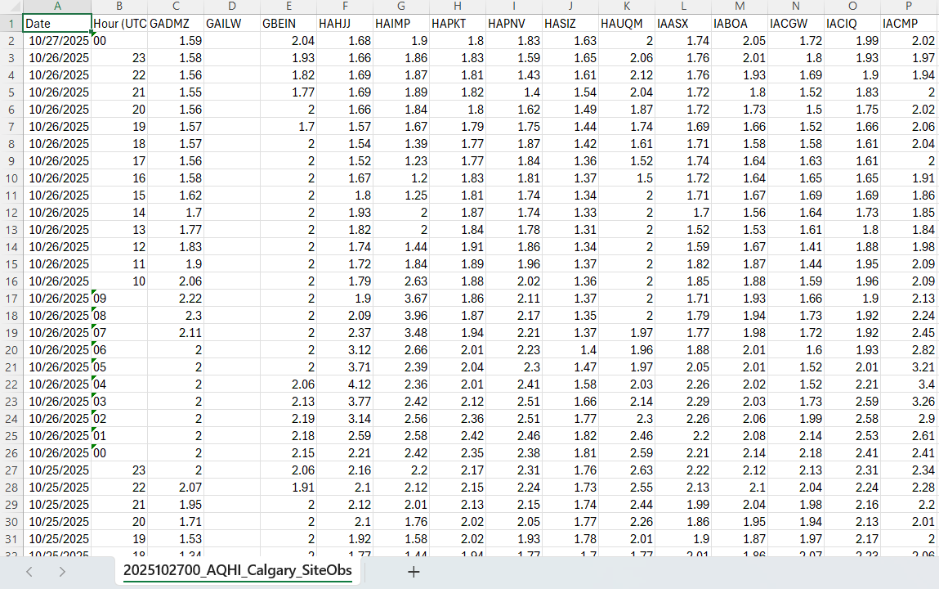
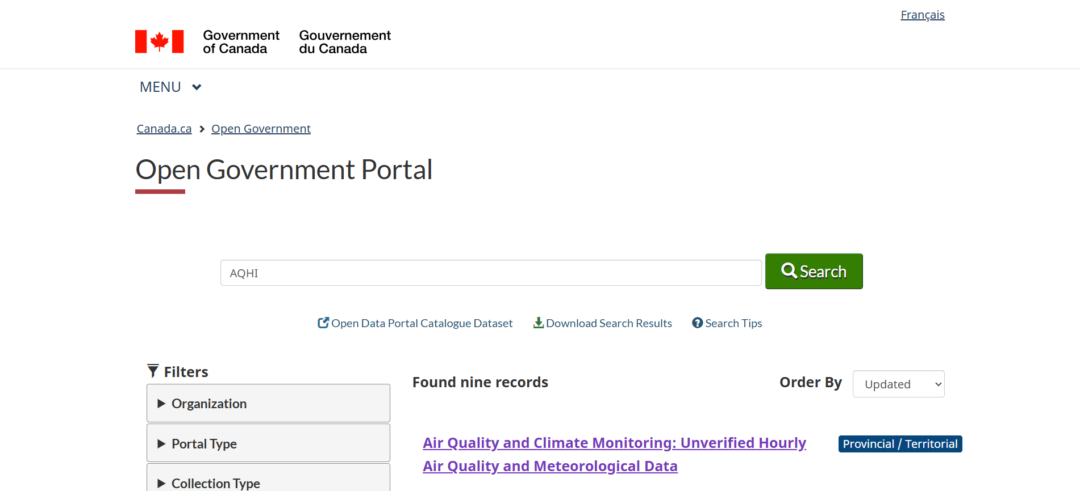
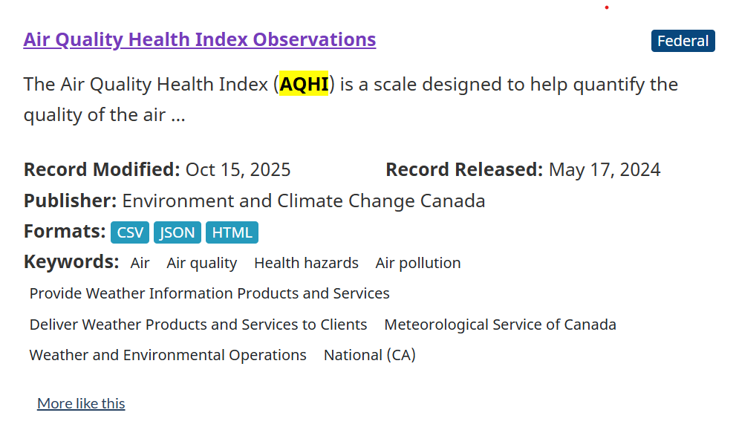
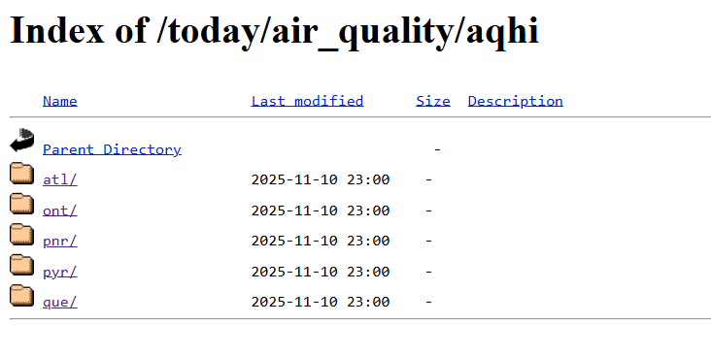
- AQHI data is recorded hourly with a timestamp for each observation.
- Each column code represents a different monitoring station within the selected city.
- Cities can have multiple stations, so data includes several readings per hour.
- The preview above shows the raw format before cleaning and processing.
Toronto + Ottawa → ont/
Calgary → pnr/
Vancouver + Victoria → pyr/

Slide 9
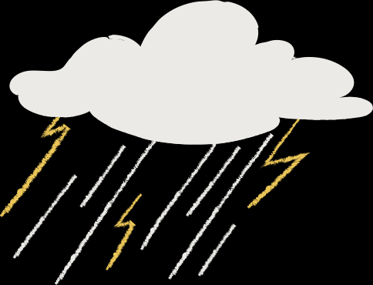


Selected AQHI Monitoring Stations (One per City)
Calgary → “IAKID” | Calgary Airshed Zone
Vancouver → “JAZBU” | Metro Vancouver Region
Toronto → “FDQBU” | Ontario AQHI Network
Ottawa → “FEVNT” | Ontario AQHI Network
Victoria → “JCLMX” | Pacific & Yukon Region

Slide 10
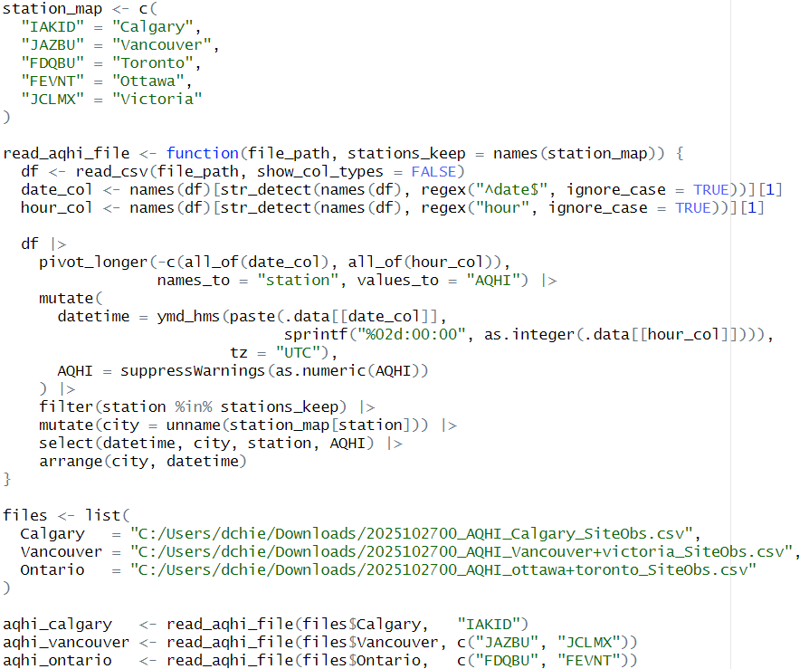
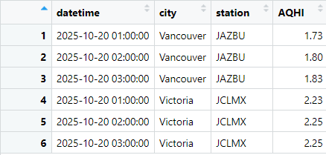
Processing AQHI Data from CSV Files

Slide 11
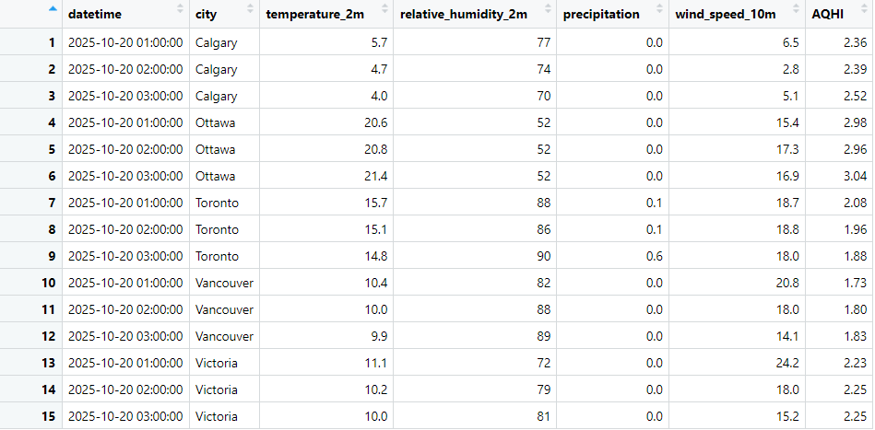
Final Combined Dataset for Analysis
📌 Combined hourly AQHI with weather data for 5 cities
📌 Aligned by city and datetime using inner_join()
📌 Final dataset ready for correlation and trend analysis

Slide 12

Research Question 1
Primary Question: How do weather conditions influence AQHI levels across Canadian cities?
Follow up Question: Which weather factor has the strongest link to AQHI based on standardized coefficients and correlations?

Slide 13
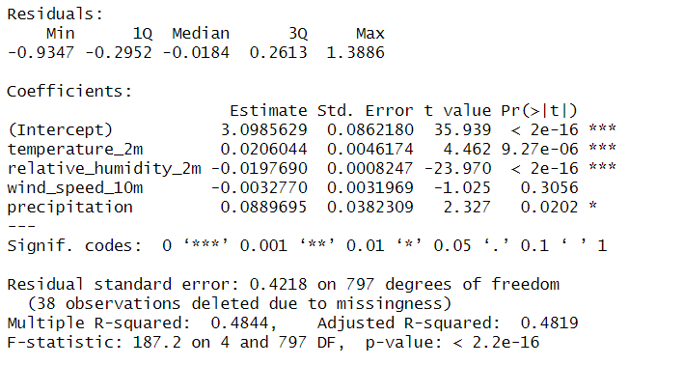


How Do Weather Variables Affect AQHI? (Regression Results)
📌 Temperature has the strongest positive effect (β = +0.0206, p < 0.001) → higher temperature increases AQHI.
📌 Relative humidity has the strongest negative effect (β = –0.0198, p < 0.001) → higher humidity lowers AQHI.
📌 Wind speed effect is negligible (β = –0.0033, p = 0.306) → no meaningful AQHI impact.
📌 Precipitation shows a small positive effect (β = +0.089, p = 0.020) → slight AQHI increase during precipitation.
📌 Model fit is moderate (Adjusted R² = 0.482) → weather explains ~48% of AQHI variation.

Slide 14
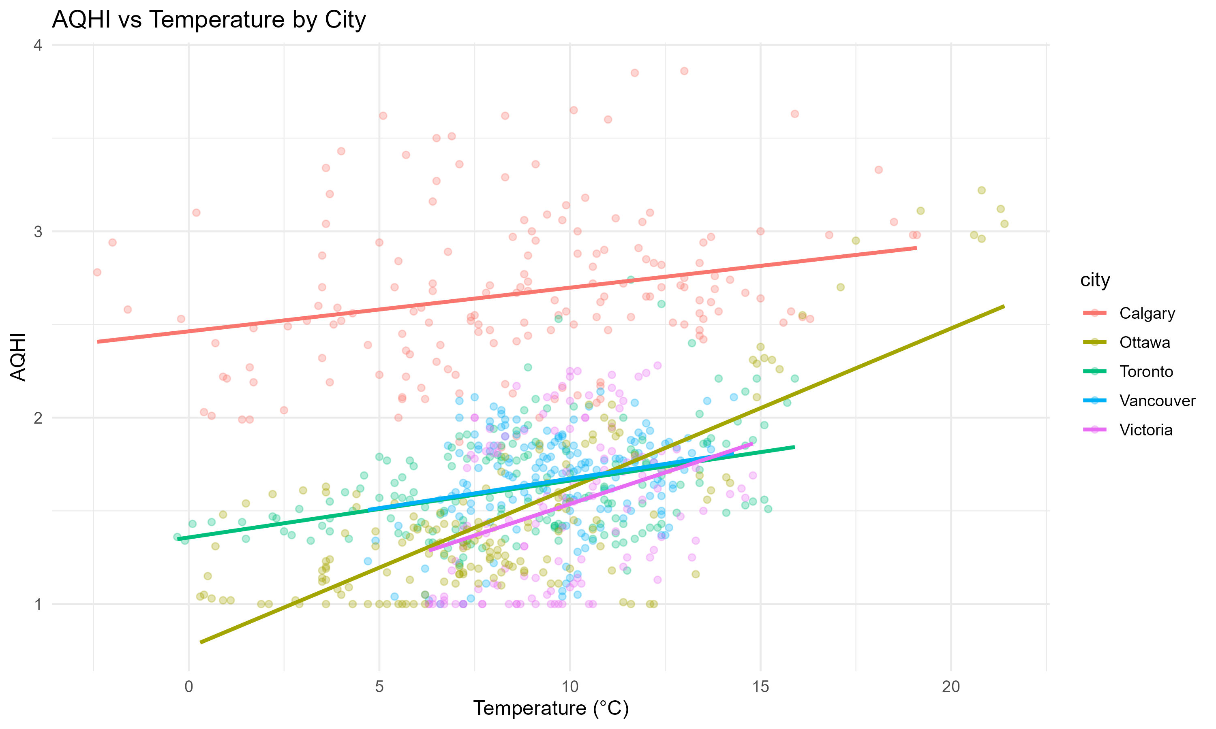

How Does Temperature Relate to AQHI Levels?
📌 Higher temperatures generally correlate with higher AQHI across cities.
📌 Ottawa shows the strongest positive temperature–AQHI relationship.
📌 Vancouver, Victoria, and Toronto show moderate positive trends.
📌 Calgary’s trend is positive but weaker compared to other cities.

Slide 15
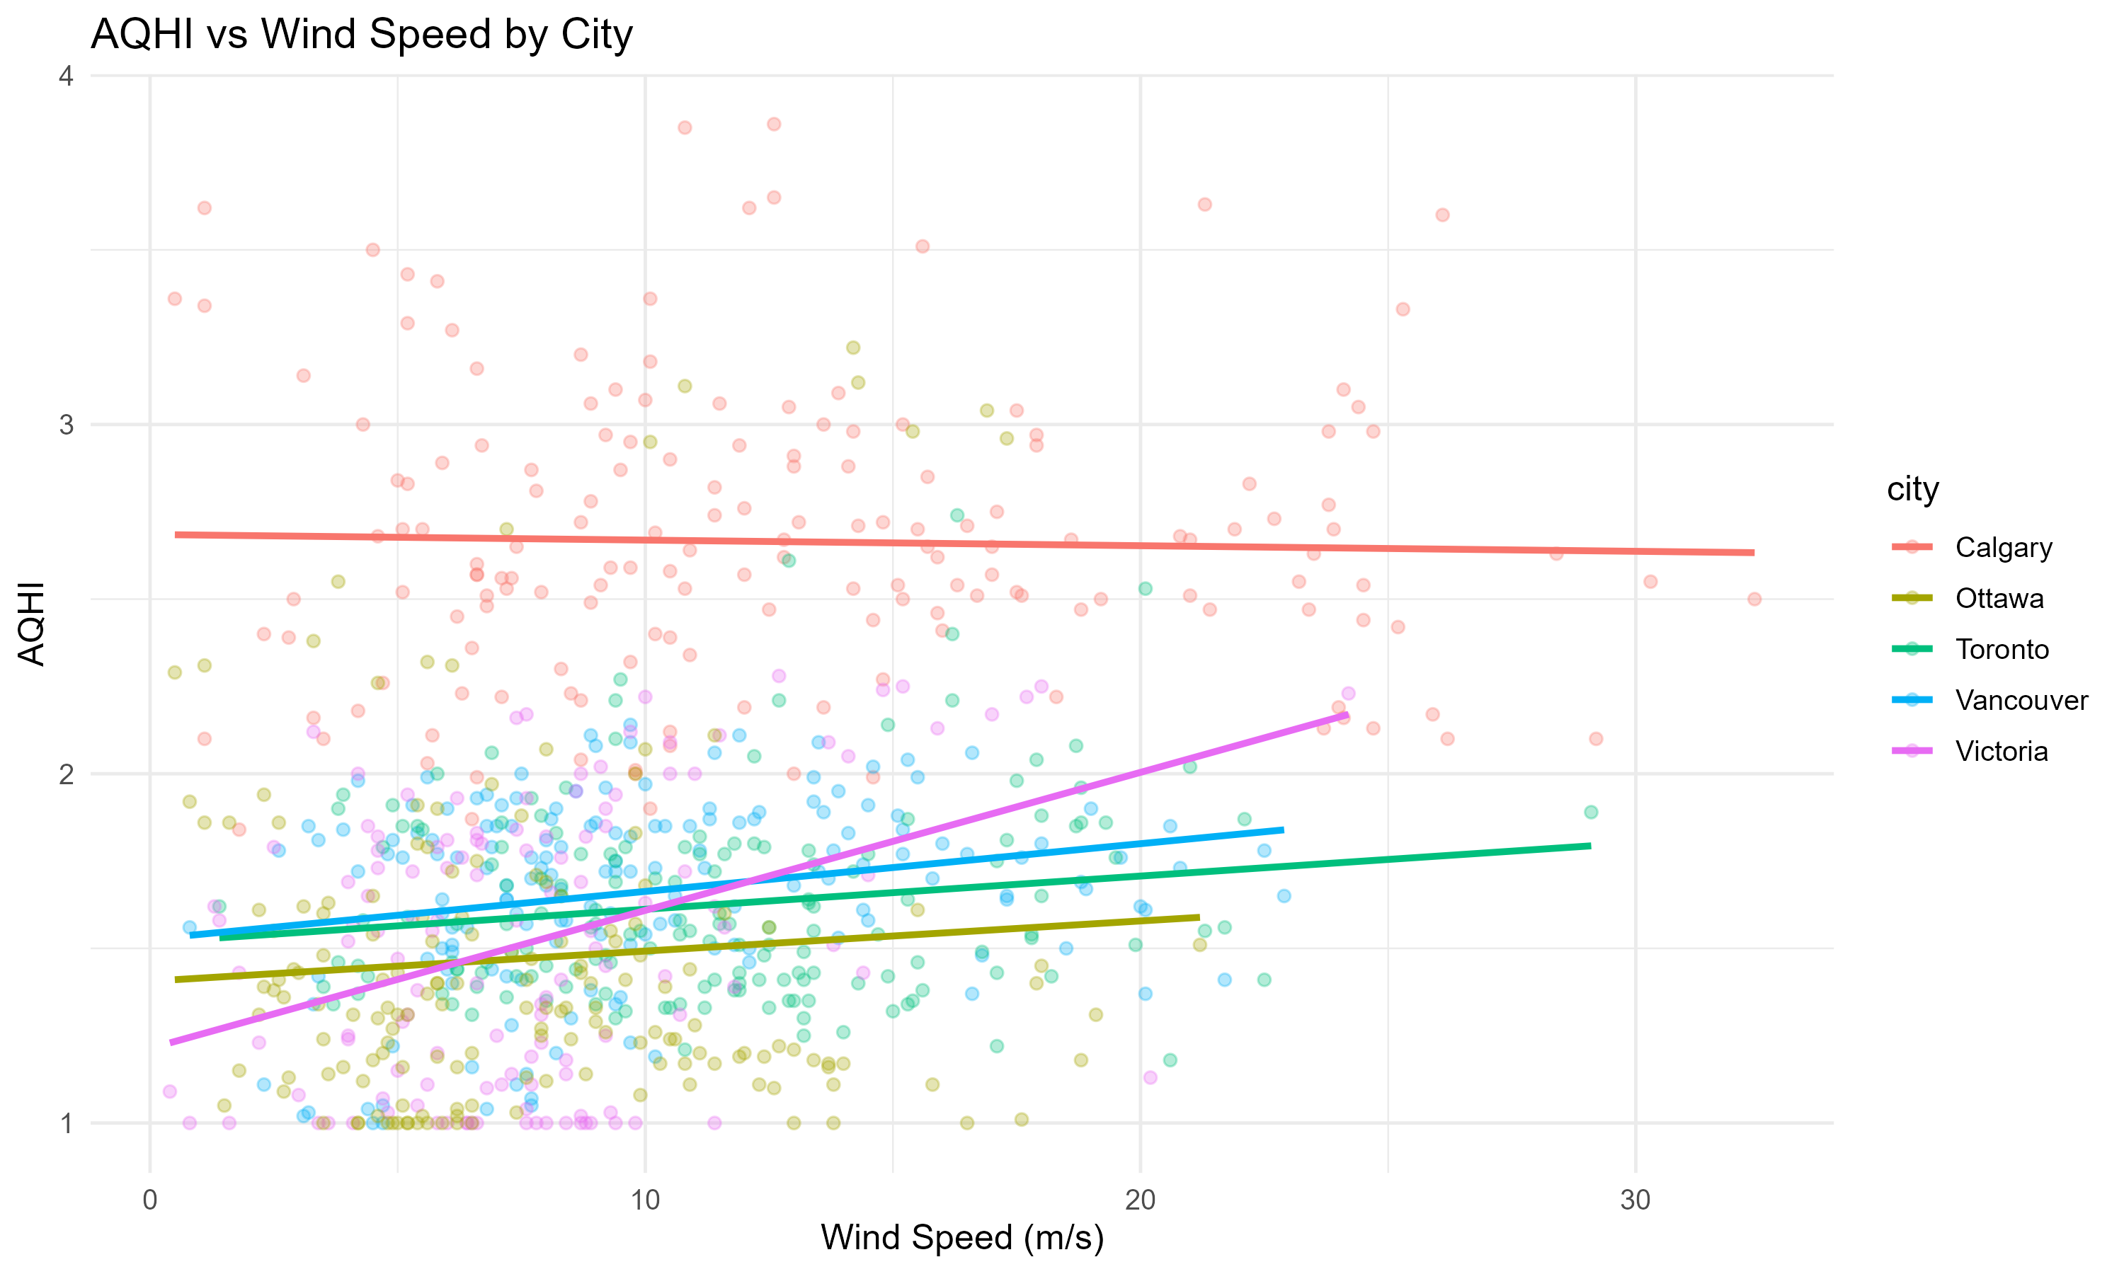

Relationship Between Wind Speed and AQHI Levels
📌 Overall weak relationship between wind speed and AQHI across all cities.
📌 Calgary shows almost no slope, meaning wind speed barely affects AQHI there.
📌 Victoria and Toronto show slightly stronger positive slopes, indicating mild increases in AQHI as wind increases.
📌 Vancouver trend is small but positive, still weak overall.
📌 Wind speed is not a too strong predictor of air quality compared to other weather factors

Slide 16
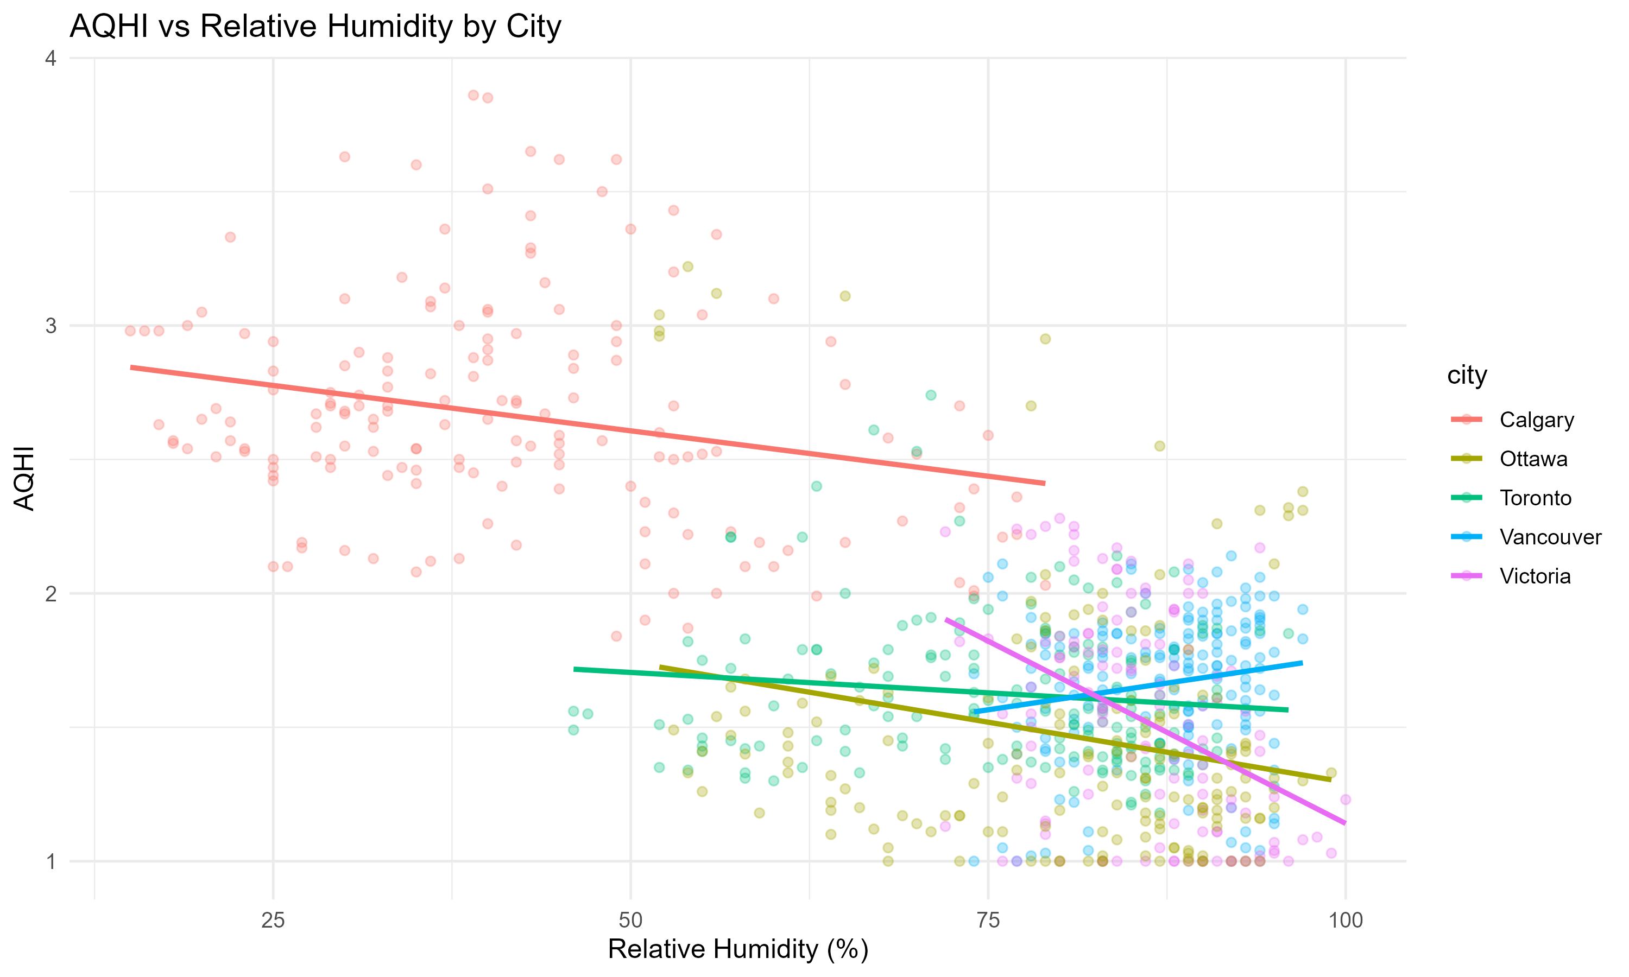

Does Higher Humidity Lead to Cleaner Air ?
📌 Across most cities, higher humidity is associated with lower AQHI.
📌 Calgary shows the strongest decrease in AQHI as humidity rises.
📌 Vancouver, Toronto, and Ottawa show mild downward trends.
📌 V ictoria also shows a decline, but clustered at very high humidity ranges.
📌 Relative humidity has a negative relationship with AQHI.

Slide 17
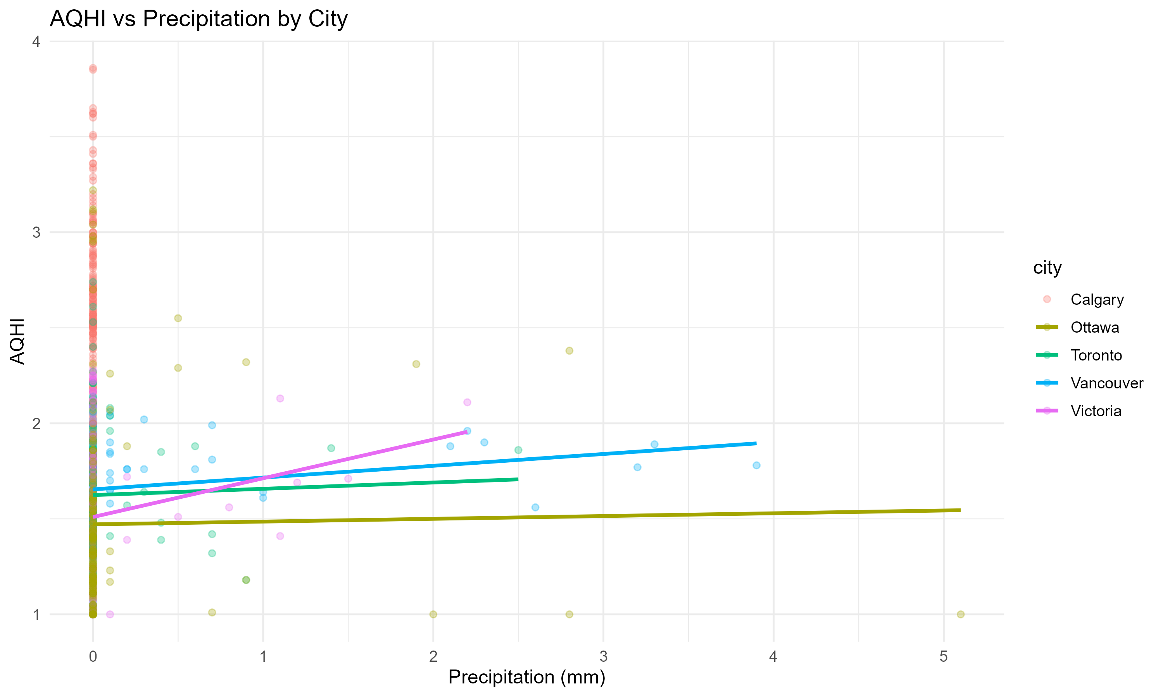
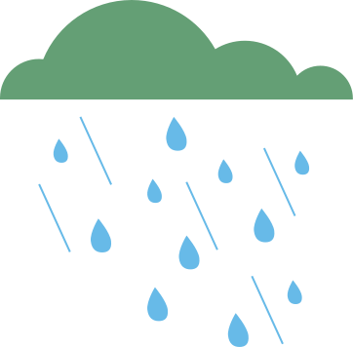
AQHI Response to Rainfall Amounts
📌 Most precipitation data is close to zero for all cities → Limited variation.
📌 AQHI shows almost no change when precipitation increases.
📌 Ottawa and Toronto show a nearly flat trend line (almost no effect).
📌 Vancouver & Victoria show a slight increase in AQHI with higher rainfall —but the effect is weak.
📌 Calgary has no precipitation data, so no trend can be observed for that city.

Slide 18
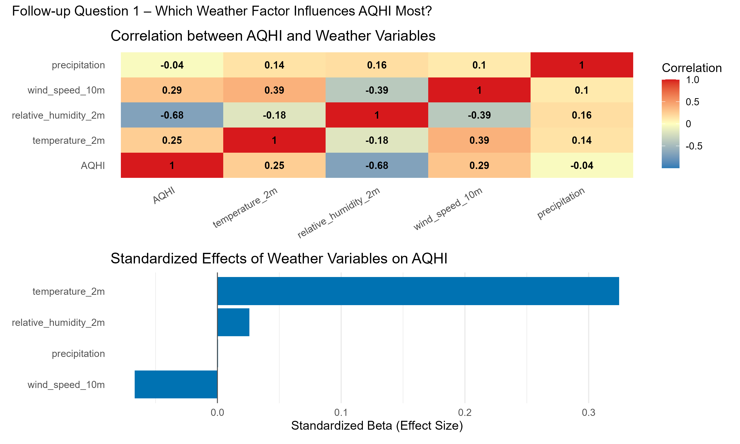

Key Predictors of AQHI: Correlation and Standardized Effects
📌 Temperature is the strongest predictor of AQHI→ Highest standardized beta & positive correlation.
📌 Relative humidity has a strong negative relationship with AQHI→ Higher humidity → lower AQHI levels.
📌 Wind speed shows only a weak effect→ Slight positive correlation, small beta value.
📌 Precipitation has almost no influence on AQHI→ Correlation ≈ 0 and effect size near zero.
📌 Results are consistent across the cities, strengthening the overall conclusion.

Slide 19



Research Question 2
Primary Question: Do inland cities experience higher AQHI levels than coastal cities?
Follow up Question: Which city have the highest and lowest AQHI levels overall and how do these differences support the inland- coastal comparison ?

Slide 20
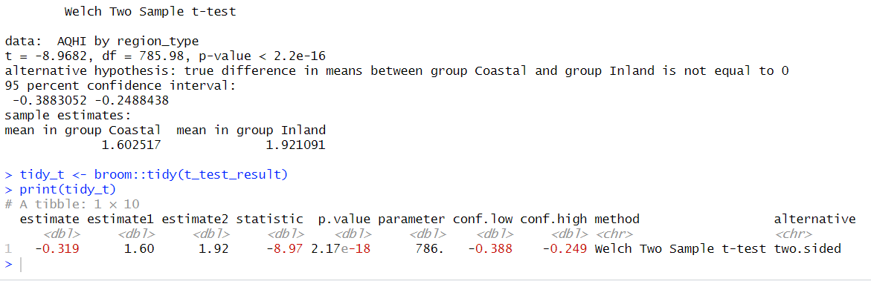
Hypothesis test – Coastal vs Inland AQHI
📌 Research Question: “Do inland cities have significantly higher AQHI levels than coastal cities?”
📌 H₀ (Null Hypothesis): There is no difference in mean AQHI between coastal and inland cities.
📌 H₁ (Alternative Hypothesis): Inland cities have a higher mean AQHI than coastal cities.
📌 Coastal Mean AQHI: 1.60
📌 Inland Mean AQHI: 1.92
📌 t-value: –8.97
📌 p-value: < 2.2e-16 (highly significant)
📌 95% CI: [–0.388, –0.249] (does not include 0)
📌 Conclusion: Inland cities have significantly higher AQHI levels than coastal cities → Reject H₀.

Slide 21
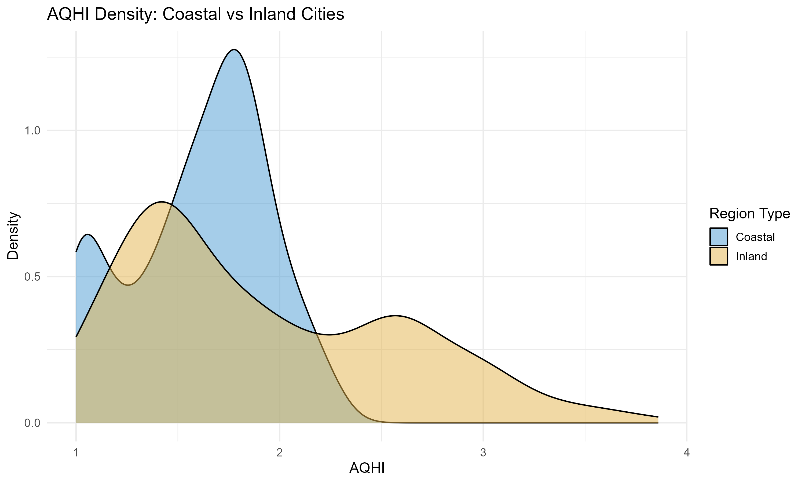
Do inland cities experience higher AQHI levels than coastal cities?
📌 Inland AQHI distribution shifts to the right
📌 Inland mean AQHI = 1.92 vs coastal 1.60
📌 Difference is statistically significant (p < 0.001)
📌 Supports hypothesis: inland cities accumulate more pollution
📌 Coastal cities have a tighter, more concentrated distribution around low AQHI (1.3–1.7).
📌 Inland cities show a wider spread with more high-AQHI observations (2.2–3.5).

Slide 22
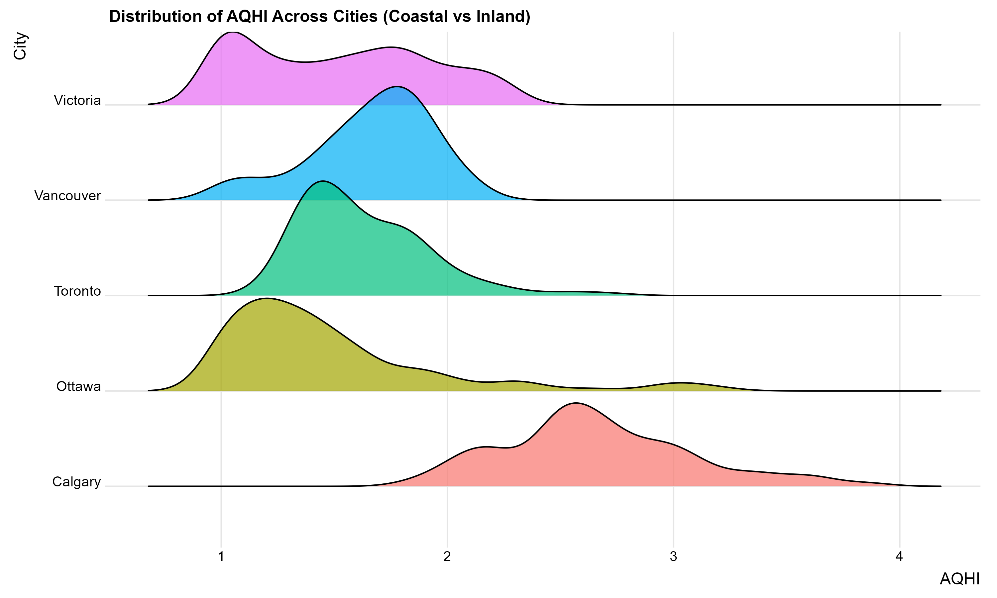
How Do AQHI Distributions Differ Across Cities?
📌 Calgary’s distribution is shifted farthest right → consistently higher AQHI
📌 Vancouver and Victoria cluster around lower AQHI values
📌 Toronto and Ottawa show mid-range profiles
📌 Overall pattern visually supports inland vs coastal contrast

Slide 23
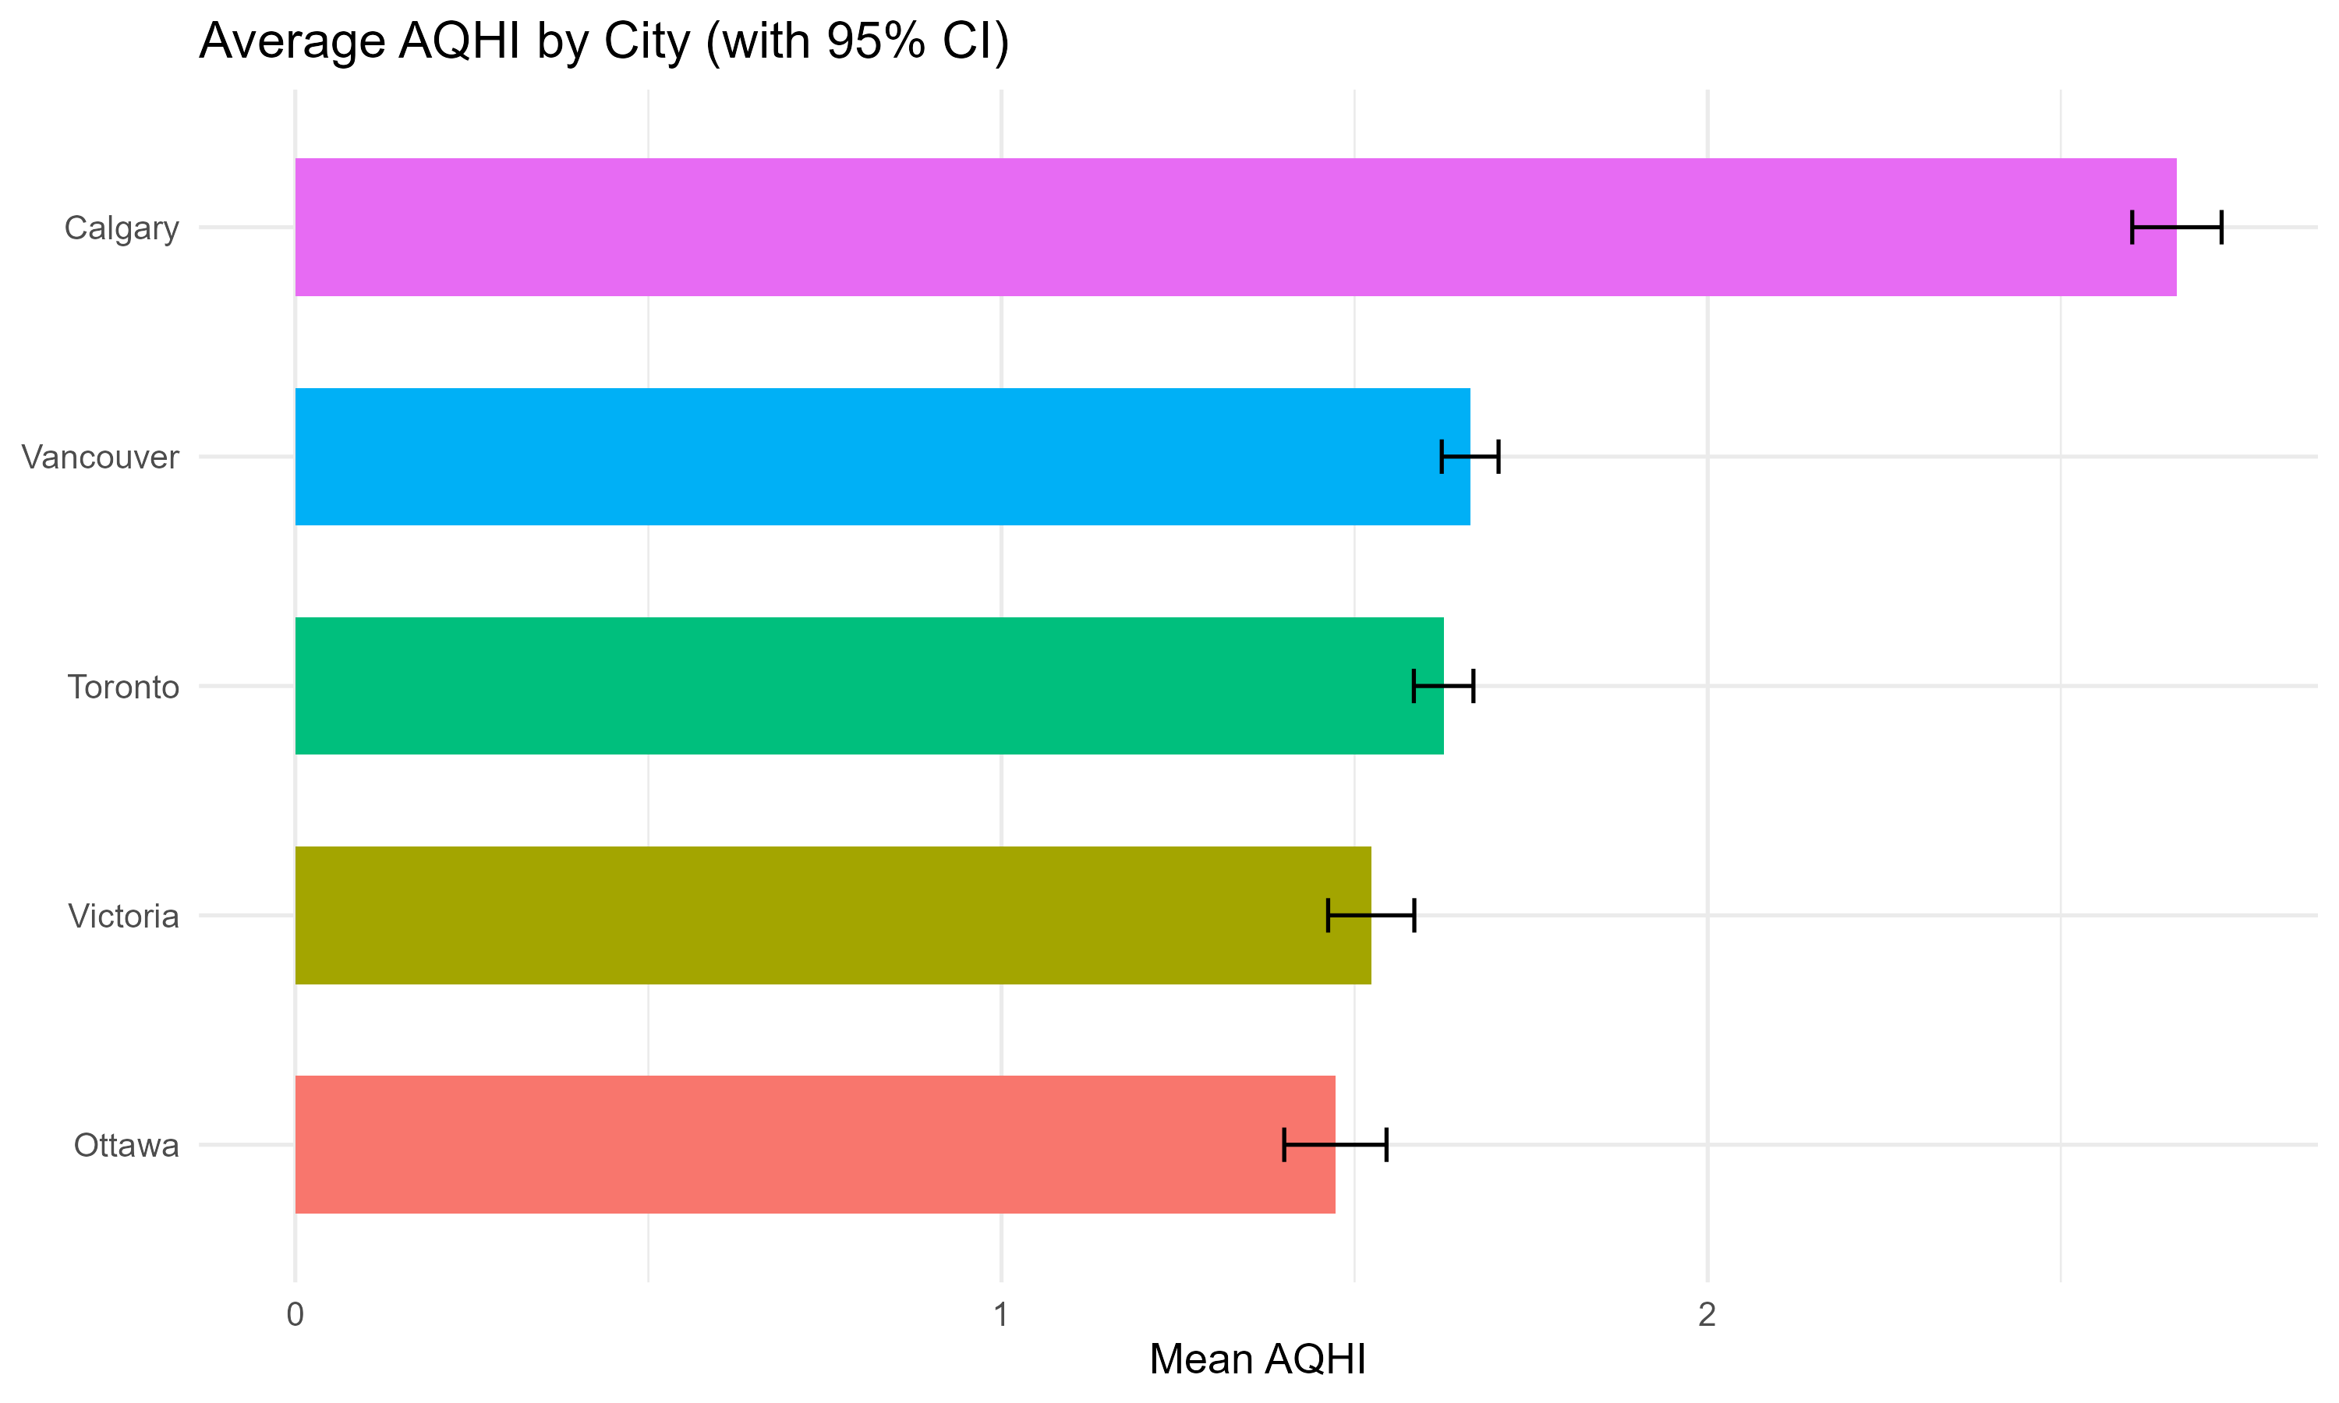
Which Cities Have the Highest and Lowest Average AQHI?
📌 Calgary has the highest mean AQHI
📌 Vancouver & Victoria have the lowest means, consistent with coastal airflow
📌 Ottawa and Toronto sit in the middle
📌 These differences reinforce that inland cities tend to accumulate more pollution

Slide 24



Research Question 3
Primary Question: Are there significant differences in AQHI levels between weekdays and weekends across the selected Canadian cities?
Follow up Question: How do AQHI patterns differ between weekdays and weekends across different times of day ( morning, afternoon, evening, night ) ?

Slide 25
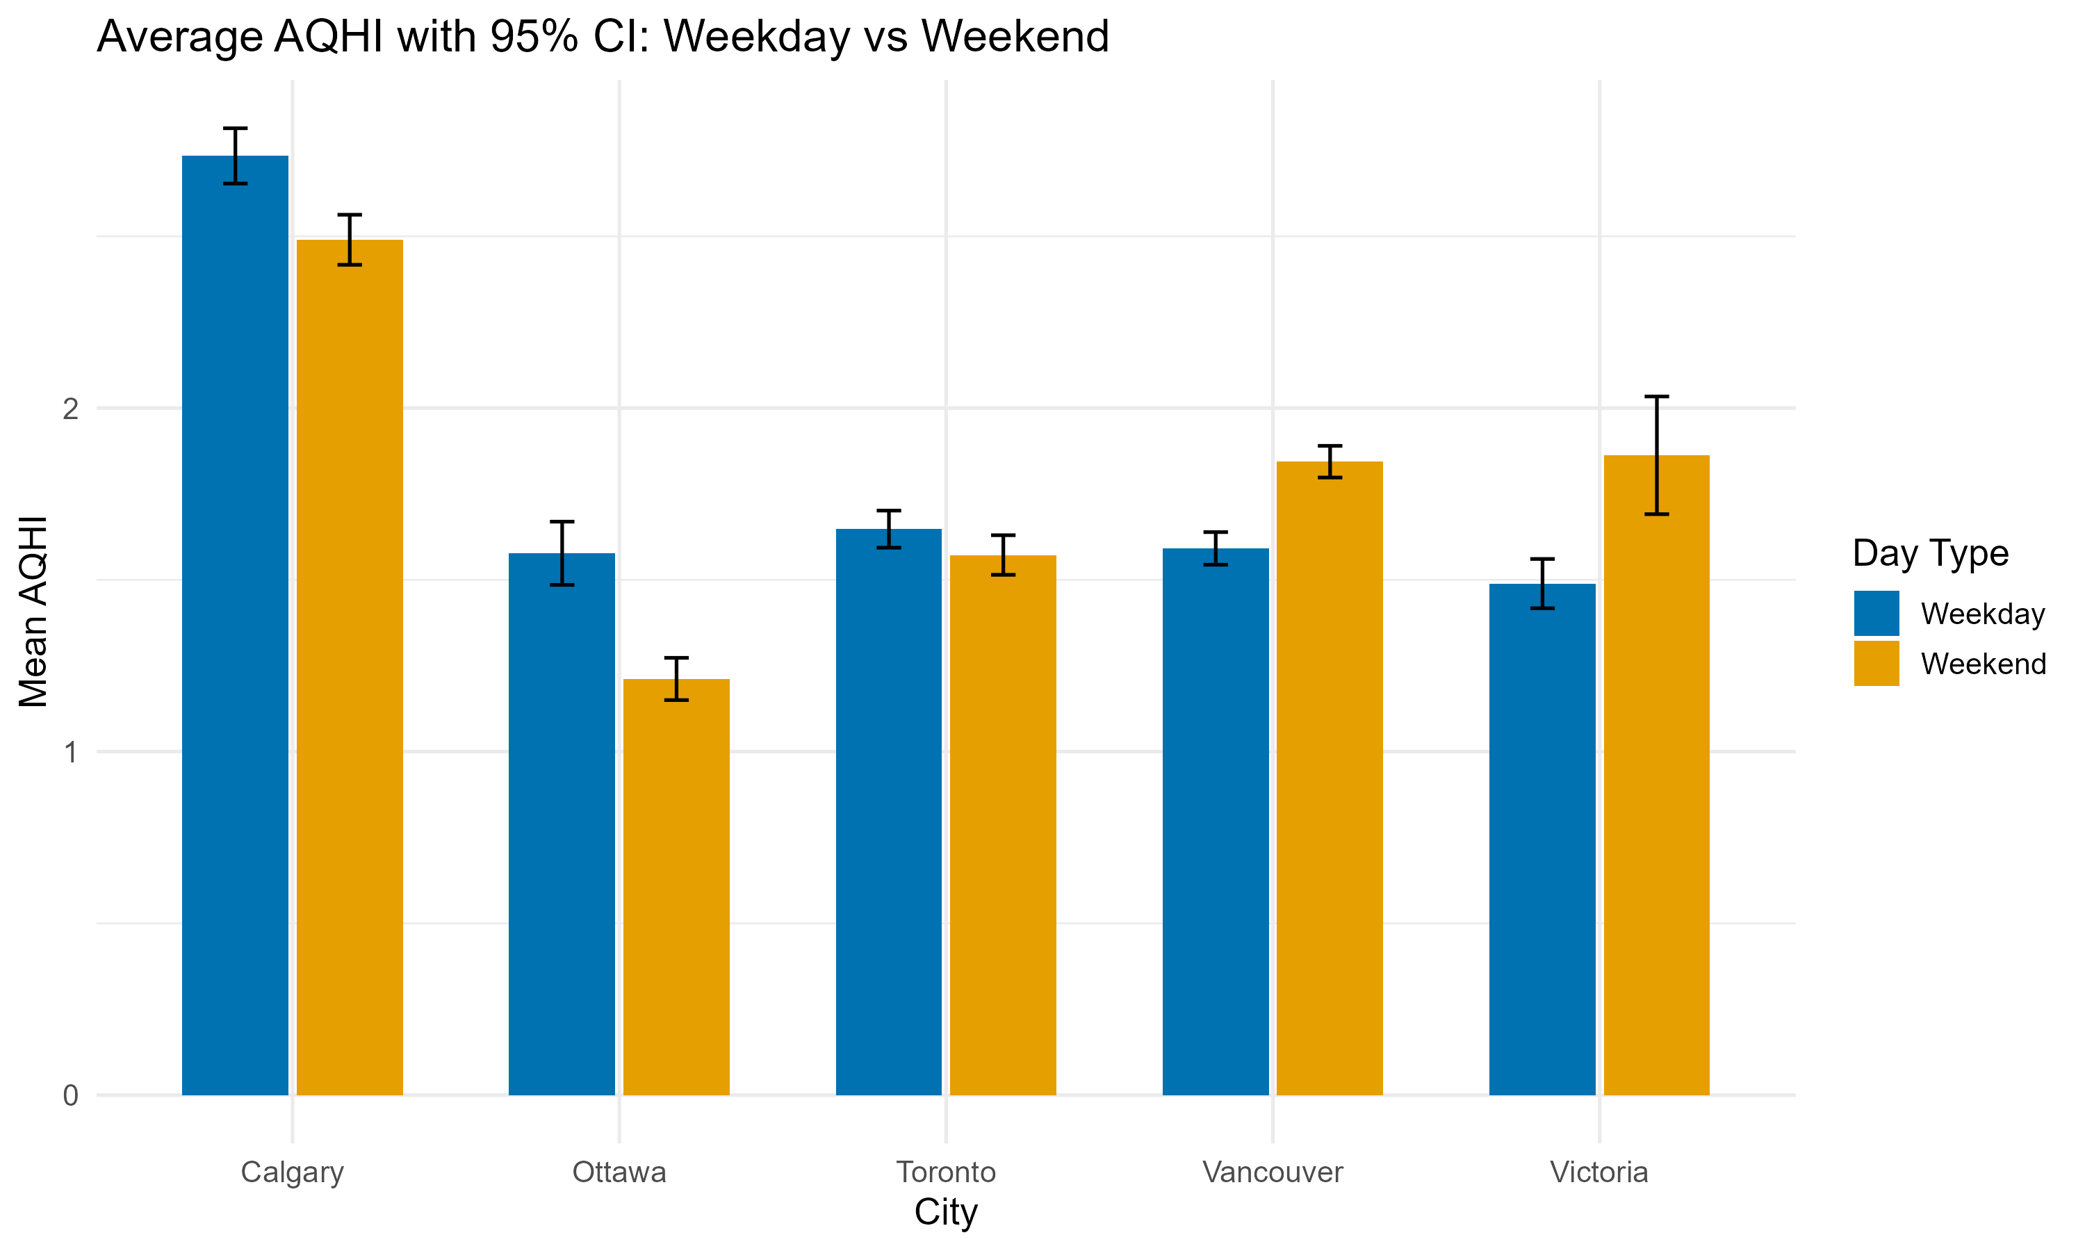
Weekday vs Weekend AQHI Differences with 95% CI
📌 Calgary has the largest weekday–weekend gap, with weekdays showing noticeably higher AQHI.
📌 Ottawa consistently reports the lowest AQHI, and both weekday/weekend levels are tightly clustered.
📌 Toronto’s weekday and weekend means are almost identical.
📌 Vancouver shows a weekend increase in AQHI, surpassing weekday pollution levels.
📌 Victoria also has higher AQHI on weekends, with a clear separation between the two distributions
📌 Overall pattern: Inland cities → Higher AQHI on weekdays.
Coastal cities → Higher AQHI on weekends.

Slide 26
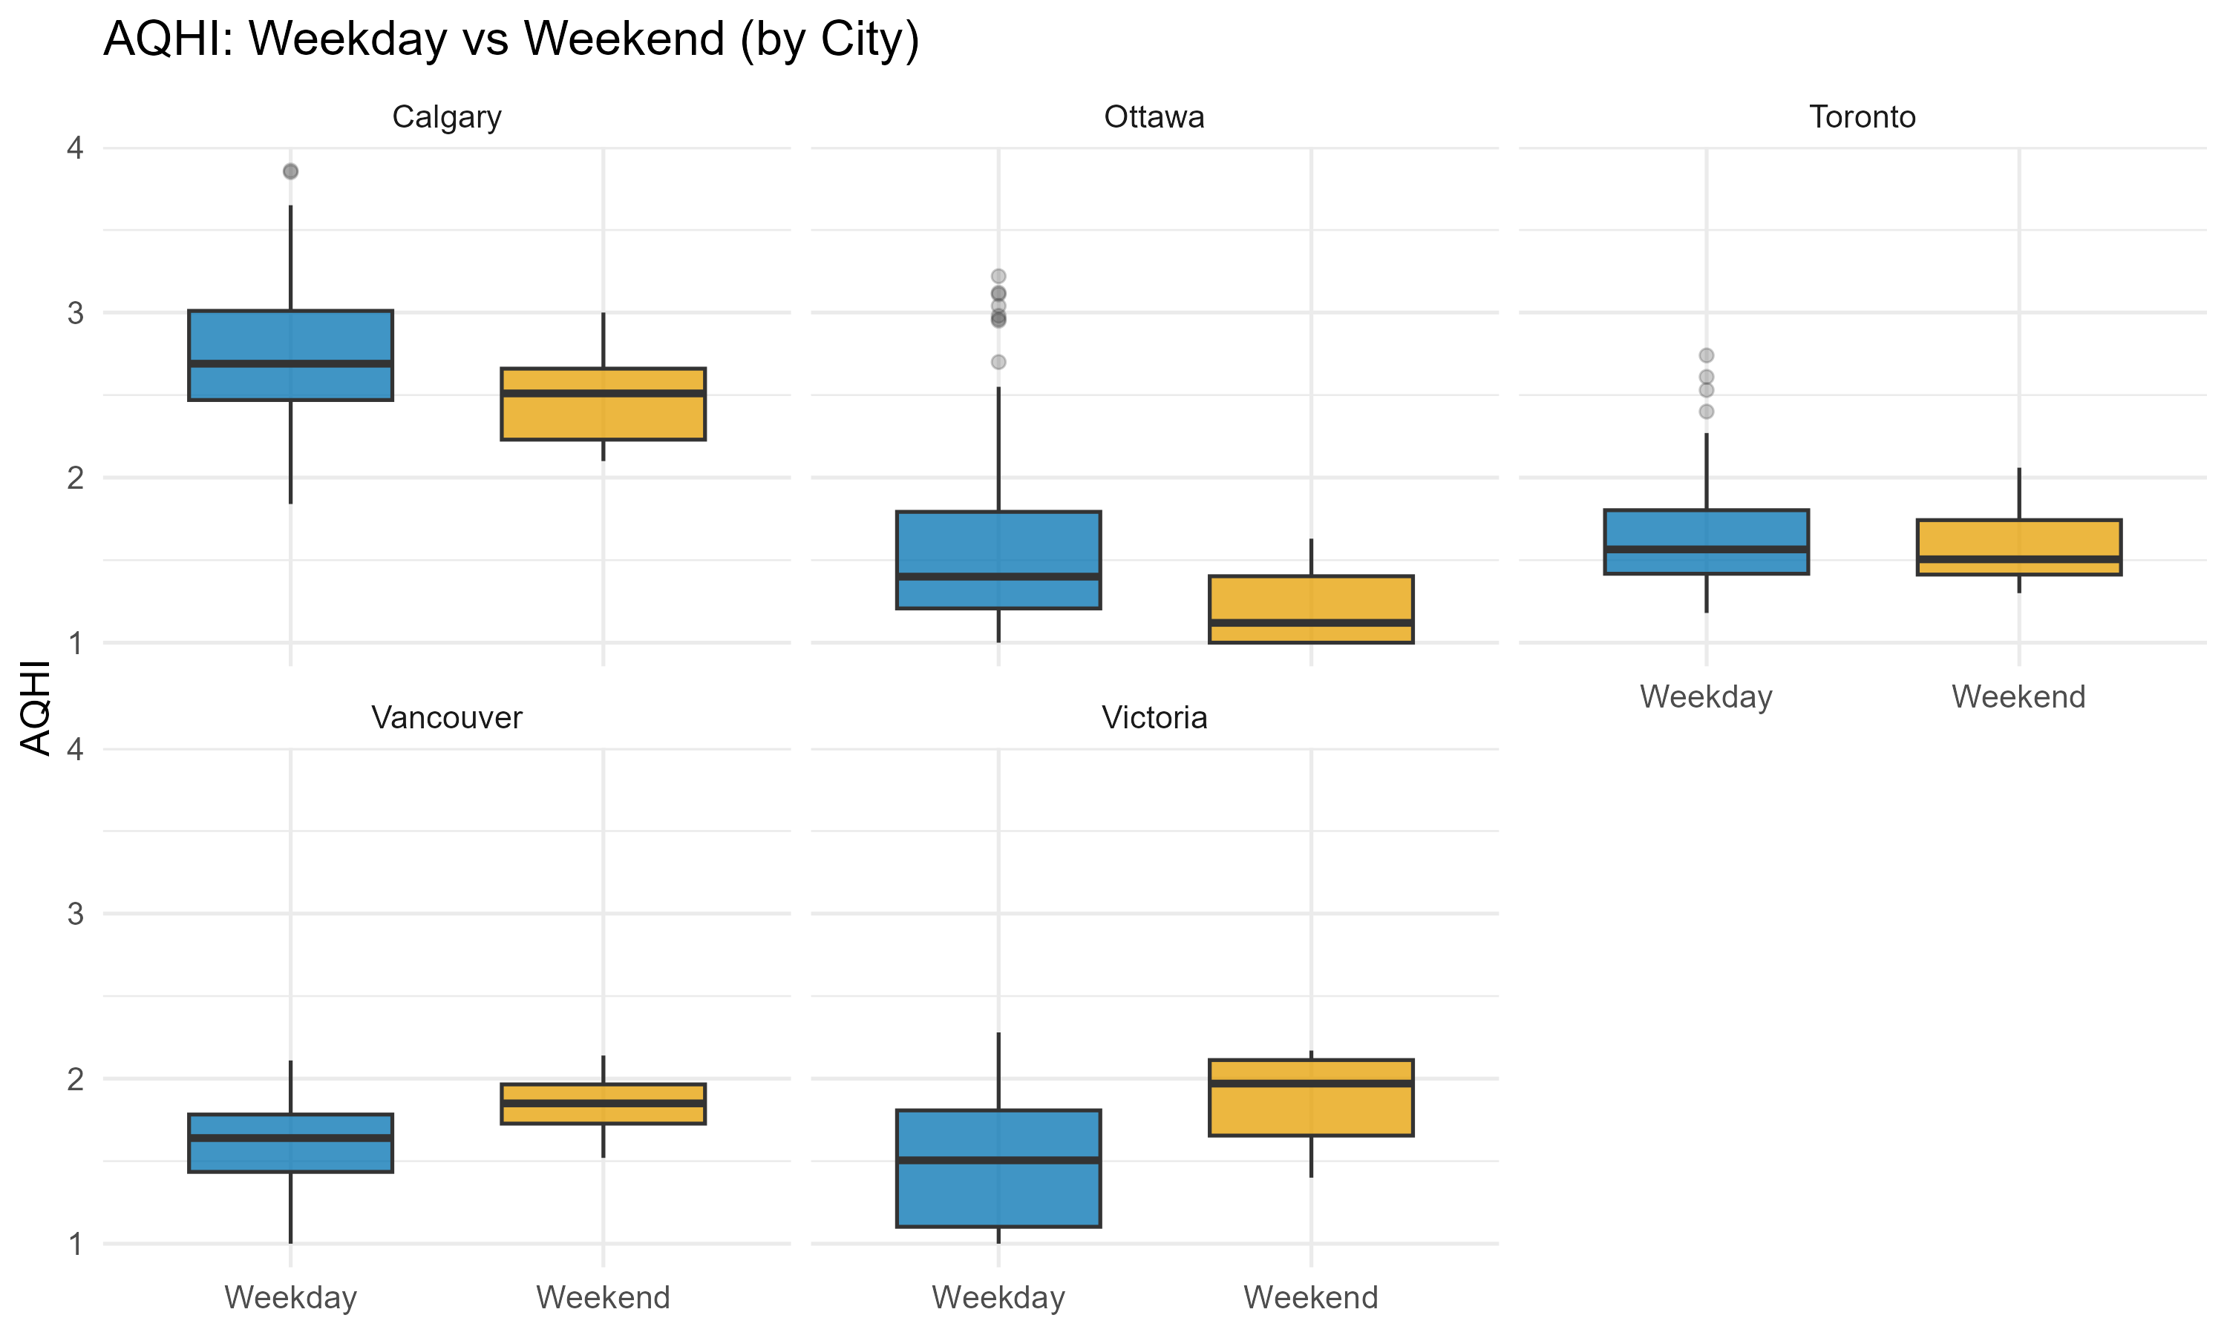
Do AQHI Levels Differ Between Weekdays and Weekends Across Cities?
📌 Calgary shows slightly higher AQHI on weekdays
📌 Ottawa has lower AQHI overall, with weekends slightly cleaner
📌 Toronto shows minimal difference between weekday and weekend
📌 Vancouver & Victoria have higher AQHI on weekends, likely from coastal traffic/activity patterns
📌 Overall: Differences exist, but they vary significantly by city.

Slide 27
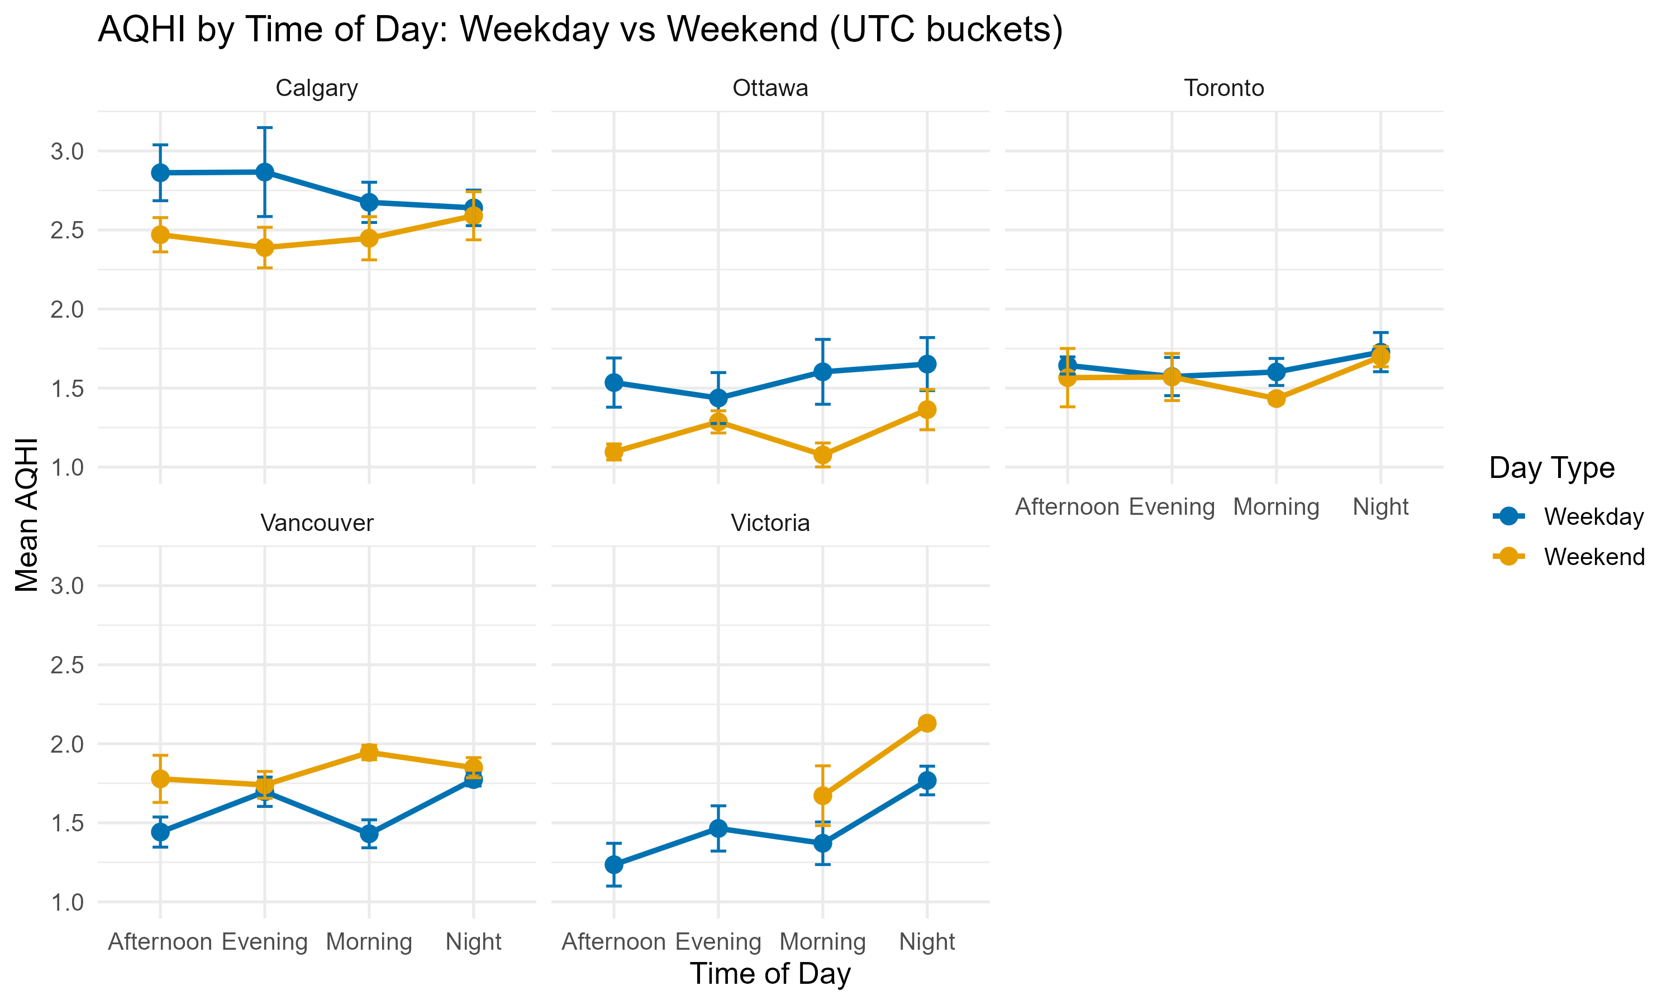
How Do AQHI Patterns Vary by Time of Day on Weekdays vs Weekends?
📌 Calgary: Weekday AQHI is consistently higher, especially in the afternoon and evening.
📌 Ottawa: Weekdays are higher in the morning and evening, while weekends rise slightly at night.
📌 Toronto: Very small differences—weekday and weekend lines nearly overlap across all times.
📌 Vancouver: Weekends tend to be higher, particularly in the morning and afternoon.
📌 Victoria: Weekend AQHI spikes in the morning and is noticeably higher at night compared to weekdays.
📌 Overall: Inland cities show higher AQHI on weekdays, while coastal cities show higher AQHI on weekends.

Slide 28
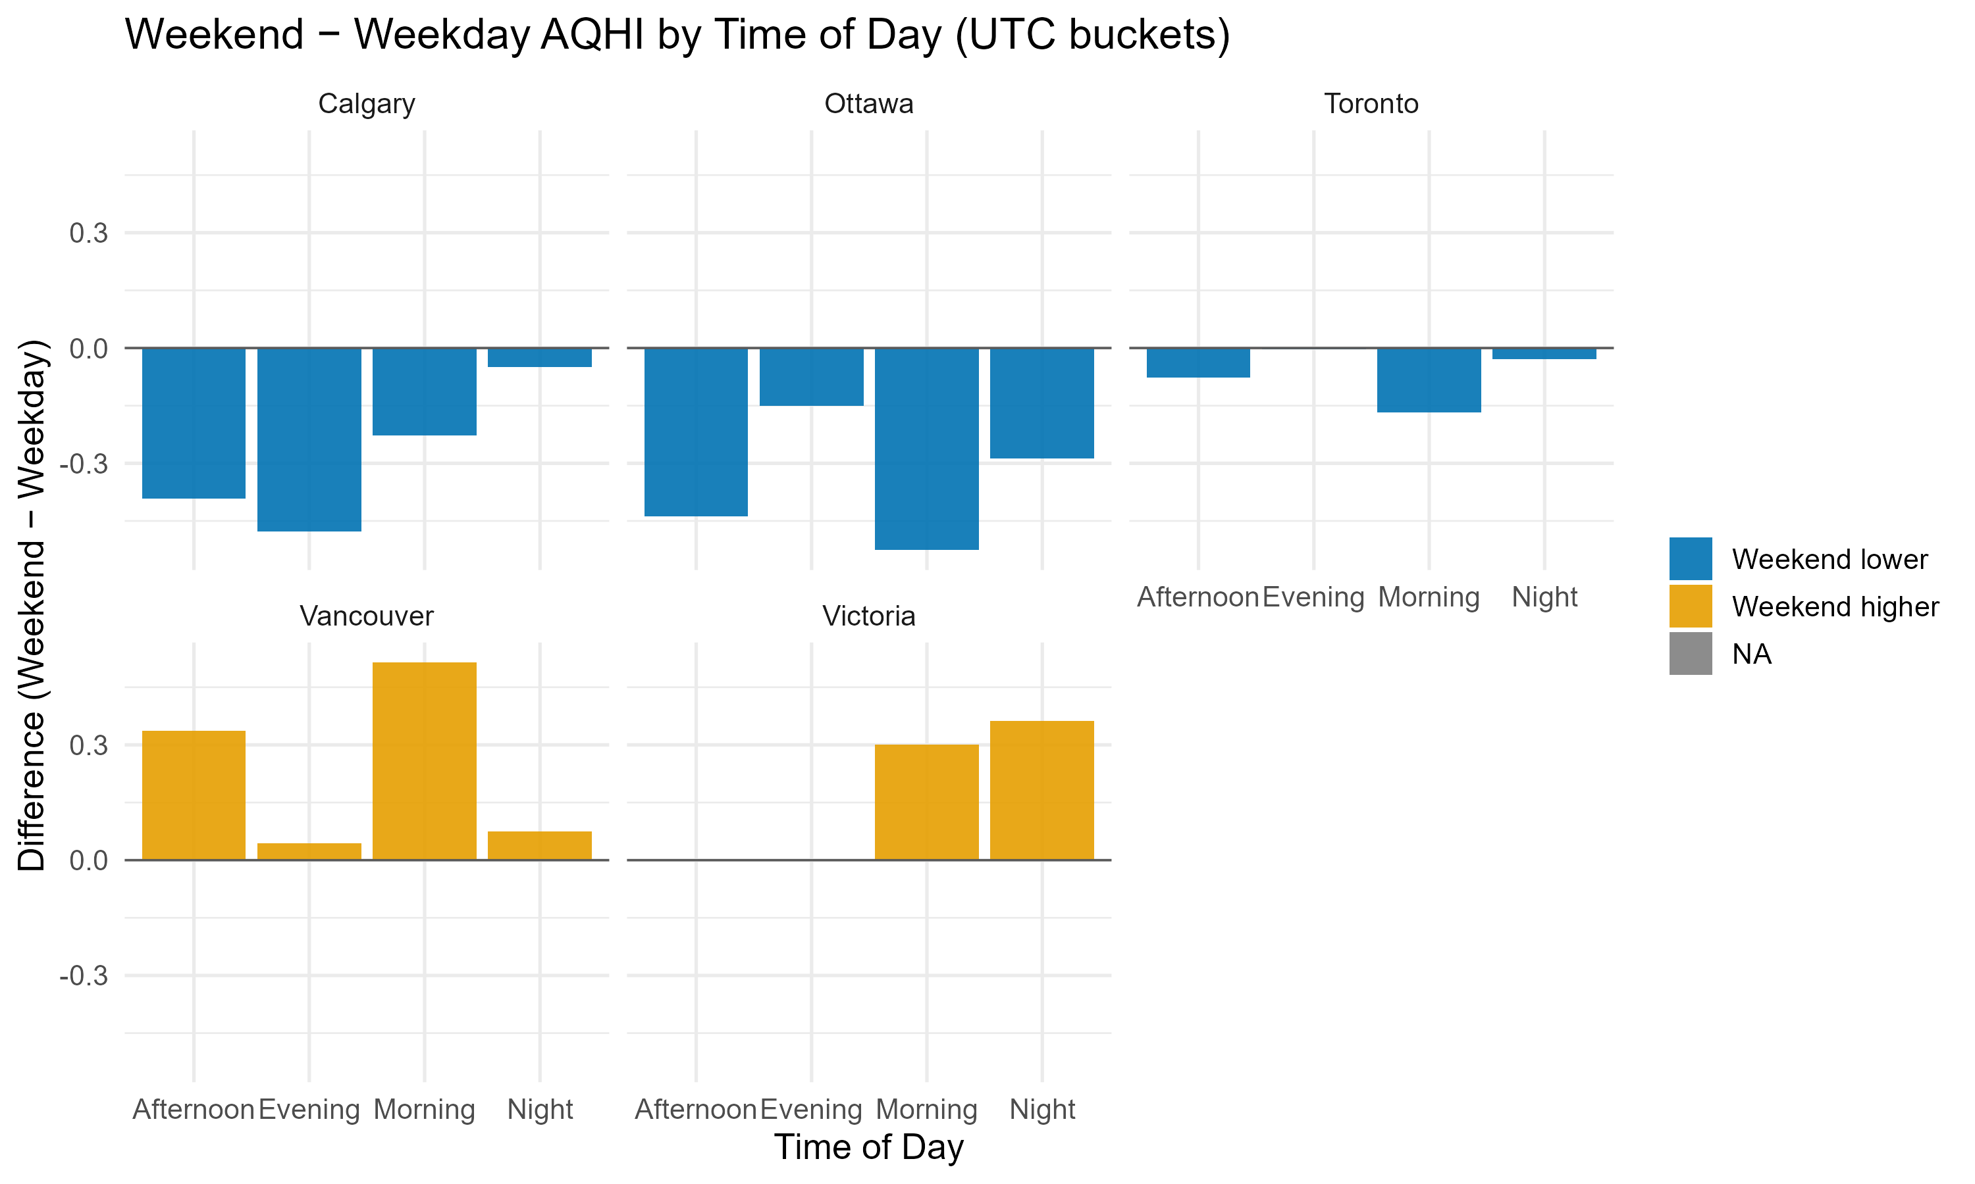
How Do Weekend–Weekday AQHI Differences Vary by Time of Day Across Cities?
📌 Calgary: Weekend AQHI lower at all times except night (almost equal).
📌 Ottawa: Weekend consistently lower, especially in afternoon/evening.
📌 Toronto: Very small differences; weekend slightly lower in morning only.
📌 Vancouver: Weekend higher in afternoon, evening, and night.
📌 Victoria: Weekend higher in morning and night, flat in afternoon.

Slide 29

Summary – Weekday vs Weekend AQHI Patterns
📌 Overall, weekday and weekend AQHI levels are very similar across all five cities.
📌 However, variation within the day differs, especially during morning and evening hours.
📌 Calgary, Ottawa show sharper weekday peaks linked to daily activity cycles.
📌 Vancouver and Victoria maintain more stable AQHI across days, with weaker weekday–weekend differences.
📌 Distribution plots show overlapping curves, confirming that day-type alone is not a strong predictor of AQHI.
📌 Time-of-day effects (morning commute, evening commute, late night) highlight when differences actually appear, even if overall means stay close.

Slide 30
OVERALL SUMMARY
📌 Weather Conditions: Temperature showed the strongest effect—higher temperatures were associated with higher AQHI levels across cities.
📌 Geographic Location: Coastal cities had more stable and lower AQHI, while inland cities experienced higher and more variable pollution levels.
📌 Time: Overall weekday–weekend differences were small, but AQHI varied noticeably by time of day, especially during morning and evening periods.
Time
Weather Conditions
Geographic Location

Slide 31
Recommendations
📌 Students and newcomers can use AQHI patterns to better understand daily air quality in different Canadian cities when choosing where to study, live, or travel.
📌 Individuals can plan outdoor activities at times of day with more stable air quality to reduce health risks.
📌 Communities and local organizations can use these findings to raise awareness about environmental conditions that affect daily life.
📌 Government and city planners may leverage these insights to support long-term strategies that protect air quality and improve urban living conditions.
Time
Weather Conditions
Geographic Location

Slide 32
Limitations & Future Work
📌 Limited time range (7 days) may not reflect long-term seasonal trends.
📌 AQHI readings sourced from selected stations; coverage differences may influence results.
📌 Weather variables such as solar radiation or air pressure were not included.
📌 Future work: extend the dataset to multiple months or seasons for stronger conclusions.
📌 Future work: analyze additional factors such as traffic volume, wildfire smoke, or human activity patterns.
Time
Weather Conditions
Geographic Location

Slide 33


Thank You
Q&A
(please feel free to ask!)

Slide 34






Free templates for all your presentation needs
For PowerPoint,
Google Slides, and Canva
100% free for personal
or commercial use
Ready to use, professional,
and customizable
Blow your audience away
with attractive visuals

